Slide 1
RETAIL SALES DATA ANALYSIS
Domain: Retail Analytics

Slide 2
Problem Statement:-
Retail businesses generate large volumes of sales data. Analyzing this data helps identify sales trends, customer preferences, and revenue-driving products.
Objective:-
Analyze retail sales transactions.
Identify top-performing products.
Measure monthly sales trends.
Understand customer purchasing behavior.
Generate business insights using SQL.

Slide 3
Dataset Information:-
Dataset Name: Retail Sales Dataset
Tools Used
MySQL Workbench
SQL Queries
Excel (Data Cleaning)

Slide 4
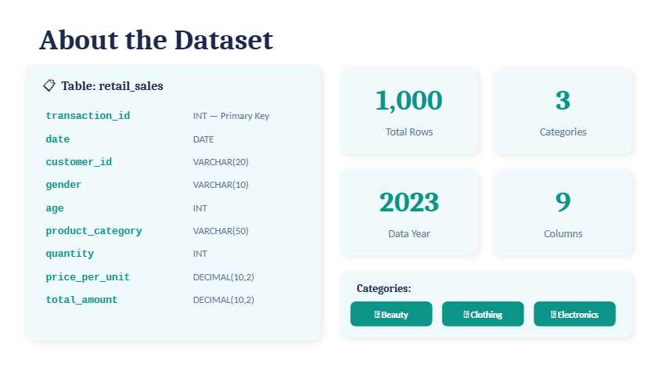

Slide 5
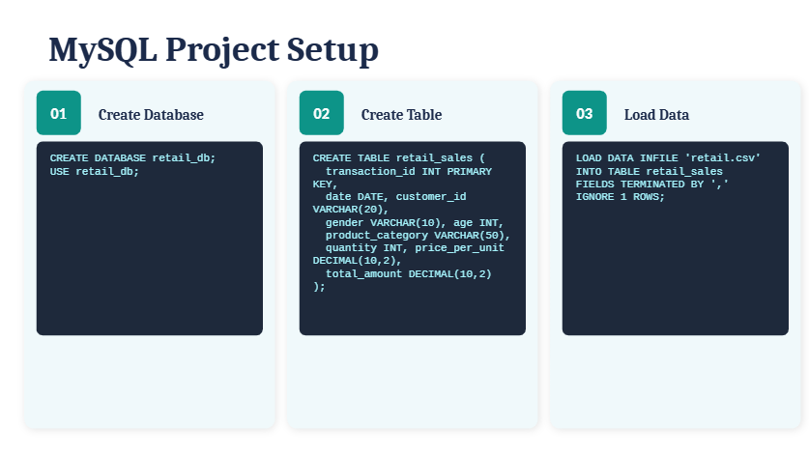

Slide 6
SQL Operations Performed:-
Data Cleaning-
Removed duplicates
Checked NULL values
Standardized date formats
SQL Concepts Used-
SELECT
WHERE
ORDER BY
GROUP BY
HAVING
Aggregate Functions
Subqueries
Window Functions

Slide 7
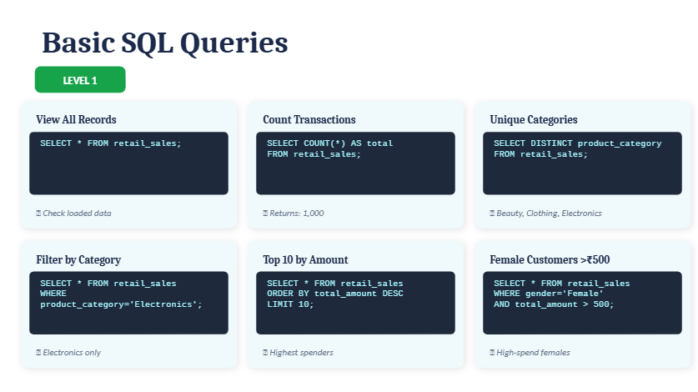
SQL Queries:-

Slide 8
Business Questions Solved:-
Key Analysis
Total Revenue Generated
Monthly Sales Trend
Top 10 Selling Products
Best Product Categories
Highest Revenue Month
Customer Purchase Frequency
Average Order Value
Revenue Contribution by Category

Slide 9
Key Findings:-
Insights
Electronics category generated the highest revenue.
Sales peaked during specific months indicating seasonal demand.
Repeat customers generated higher revenue.
Certain categories had higher average order values.

Slide 10
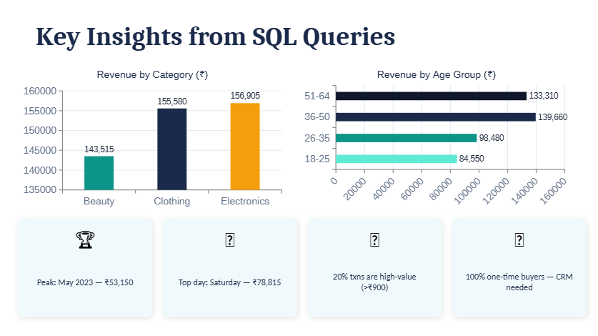

Slide 11
Conclusion:-
Successfully analyzed retail sales data using SQL.
Identified revenue trends and customer behaviour patterns.
Generated actionable business insights.

Slide 12
